Slide 1
Business Analytics using SQL and Python Final Project
-Nithya Muruganantham

Slide 2
Business and its Questions
Business: SuperFoodsMax
SuperFoodsMax is a national grocery chain with stores in all states and territories of Australia.
SuperFoodsMax is a small player with around 8% of the national grocery market share.
Questions:
SuperFoodsMax wants to lift sales revenue over the next two years.
The average spend of their loyal customers is not increasing which is stagnating the revenue growth.
The first-time customers are not converting to regular customers.
The questions are:
How to increase the average spend of loyal customers?
How to convert the first-time customers to regular customers?
Any other way to increase the revenue growth?

Slide 3
Data Collection The data was sourced from one of the stores of SuperFoodsMax as a sample. The transaction date ranges from January 2017 to May 2020 and it has the necessary details required for data analysis like ageband, commodity, household type, etc. I believe this dataset will help me analyse the various levels of loyalty, analyse trends of the current and archived purchases, predict the future trends and hence answer the questions posed by the business. The data has below details from the store. 1. customer_id 2. basket_id 3. product_id 4. loyalty of the customer 5. household_type 6. age-band 7. department 8. brand 9. commodity 10. transaction_date 11. price 12. store number 13. days_since_first

Slide 4
Ethical and Legal considerations The data used in this project was sourced from one of the stores of the SuperFoodsMax company. It does not include any personal information that would identify any individual person by any means by name, date of birth, address, financial details or any other information. I hope the individuals were informed at the point of data collection about how their data may be used. Data used was handled with utmost consciousness and fair bias and honesty.

Slide 5
Data Cleaning On analysis using python libraries like pandas and numpy, the following details were found, and the data was cleaned and exported to a new file called “cleaned_dataset_2017_2020.csv”.
Validity:
The customer_id of SuperFoodsMax company has only 5 digits. On checking, I found 19 customer_ids which were 7 digits in length. These were trimmed to 5 digits. Other columns were also checked.
Accuracy:
The dataset was checked for any duplicate values. There were 1634 duplicates, and these were removed.
Completeness:
The dataset did not have any null values.
Consistency:
The transaction_date was a stored as a string, so it was converted to date type using python.
The age_band did not have the age 65 included, so the value “Greater than 65” was changed to “65 and above” to include the age group.
Uniformity:
The price column was checked for currency & it was found to be uniform throughout the dataset.
The transaction_date was used to find the year and month and was added to the dataset in two separate columns

Slide 6
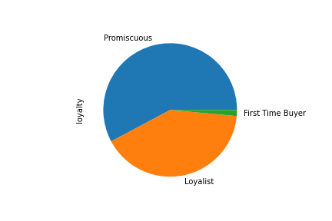
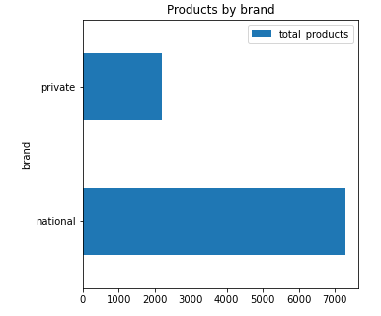
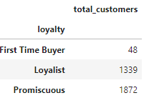
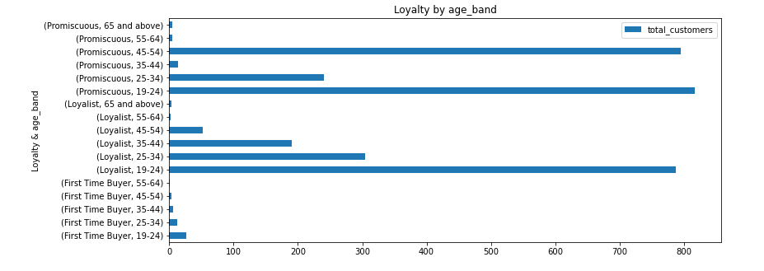
Data Analysis
The customers are categorized into 3 Loyalty types
Loyalist
Promiscuous
First-time Buyer
The customers are divided into 6 age bands
19-24
25-34
35-44
45-54
55-64
65 and above
There are 2 brands of products
National
Private

Slide 7
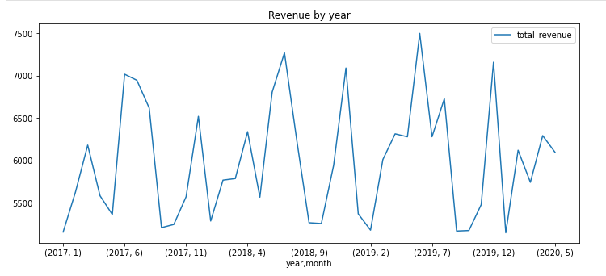
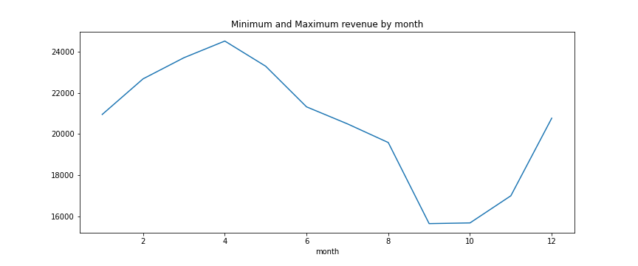
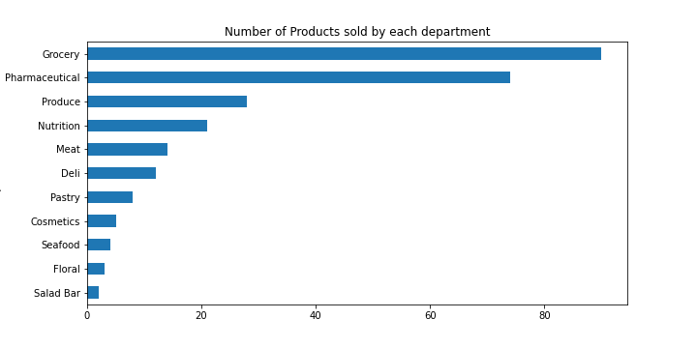
The revenue of the store has a seasonal trend over a year. The revenue is lowest during September-October and highest in April.
Grocery has the highest number of products followed by Pharmaceuticals and Produce.

Slide 8
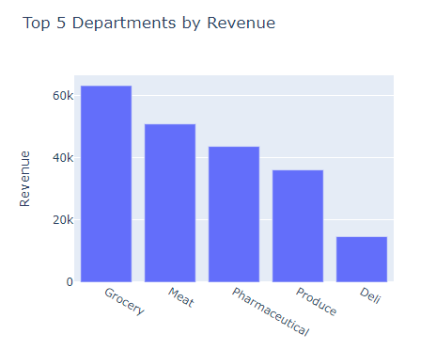
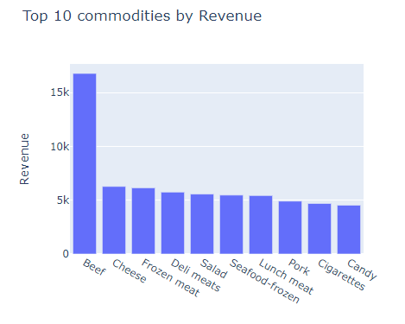
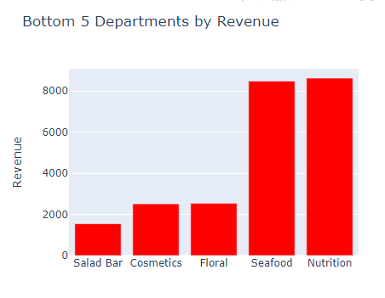
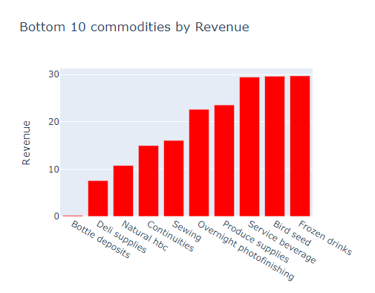
Revenue analysis by Department and Commodity

Slide 9
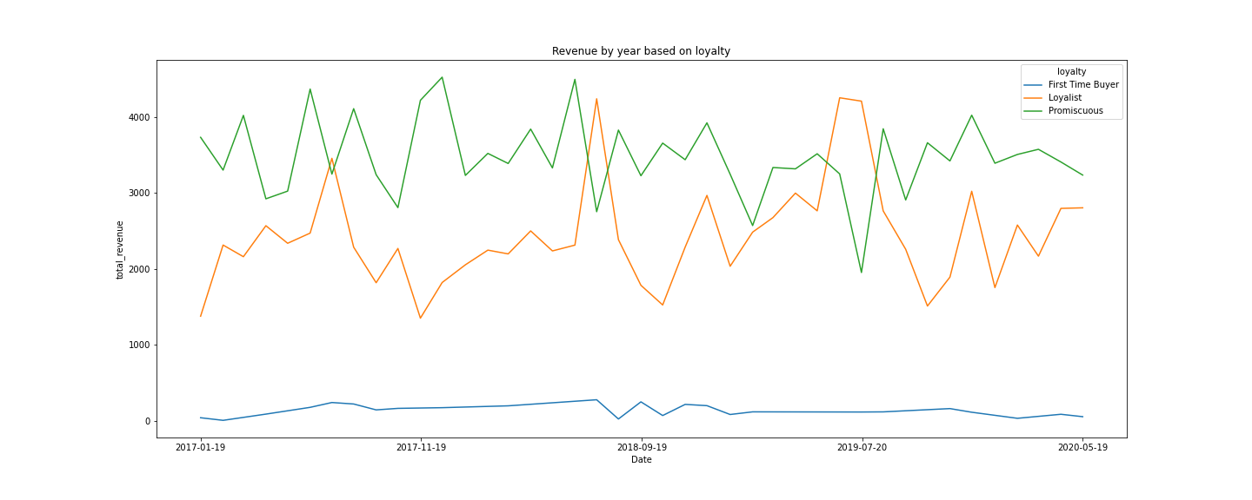
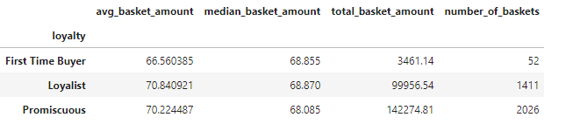
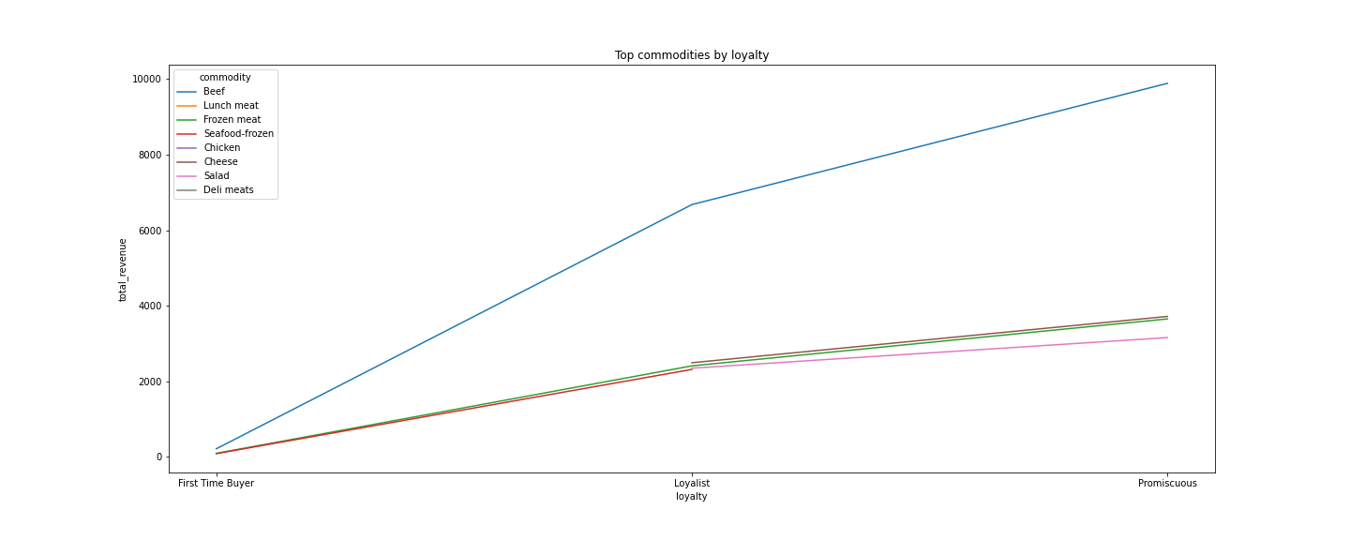
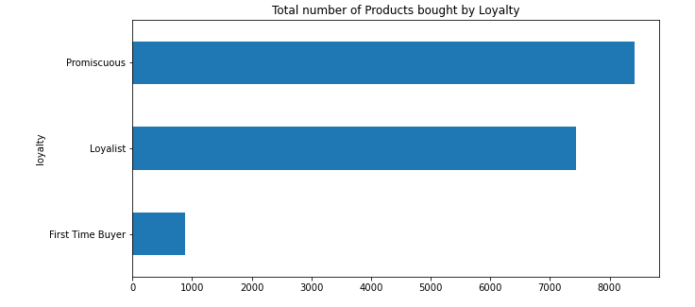
Analysis by Loyalty Type

Slide 10
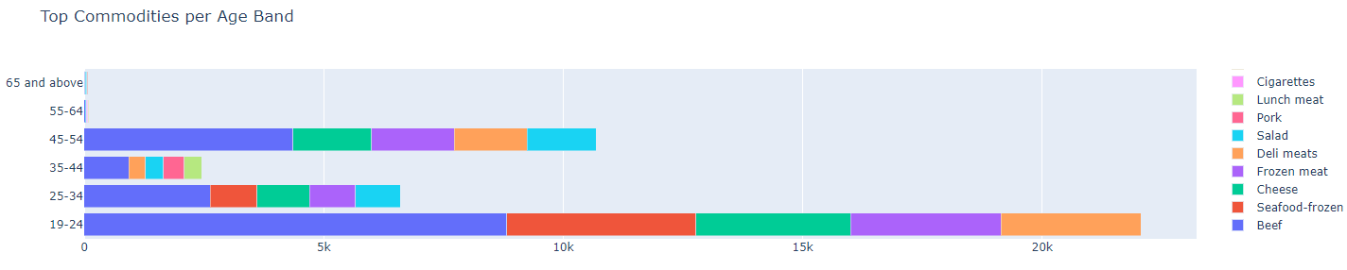
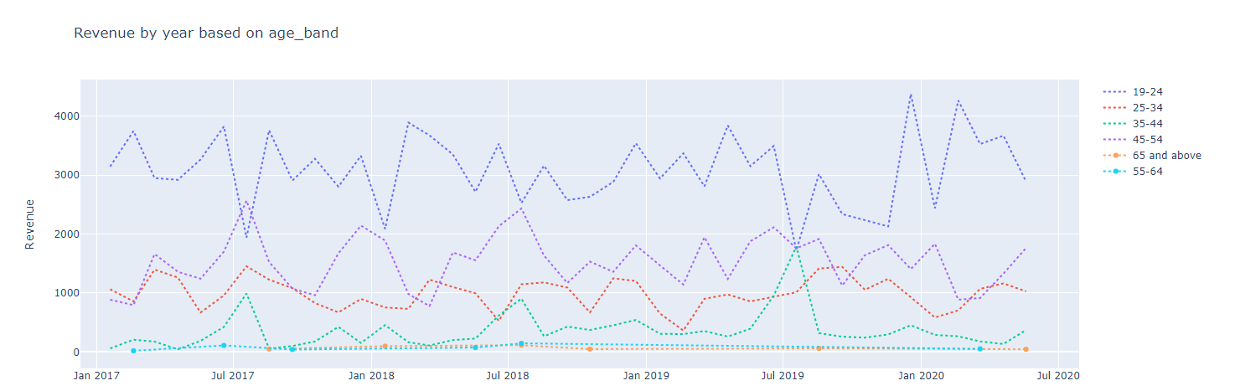
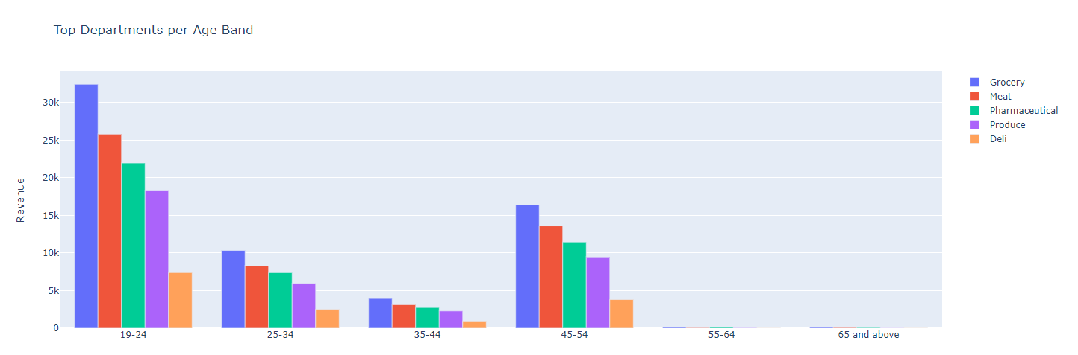
Analysis by Age Band

Slide 11
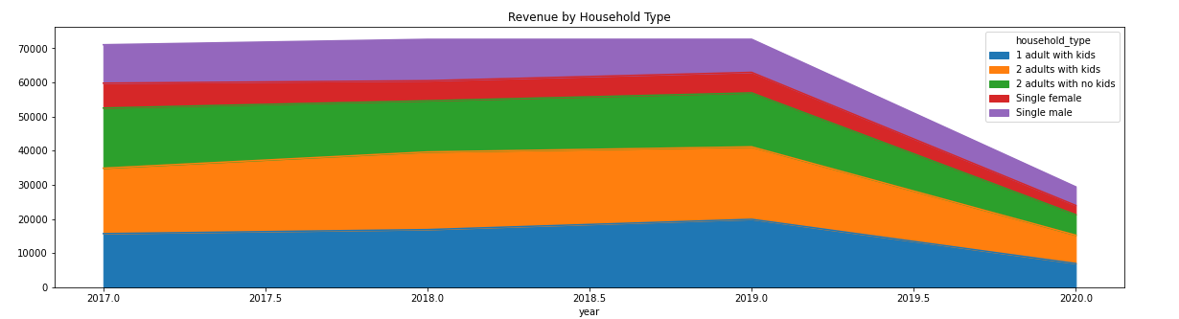
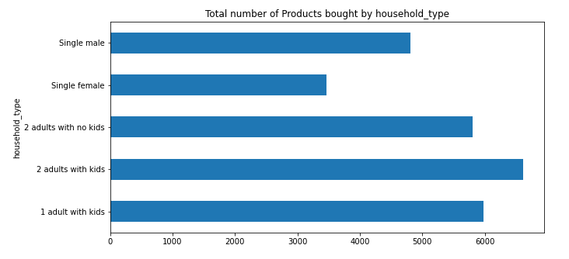
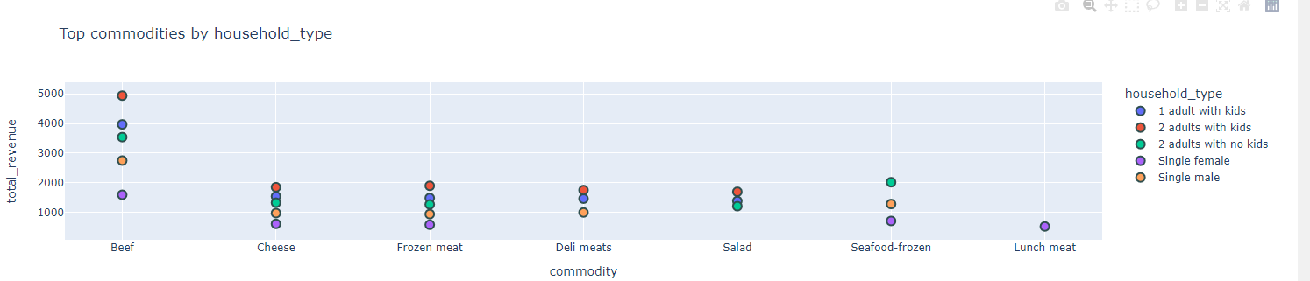
Analysis by Household Type

Slide 12
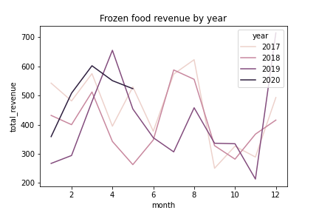
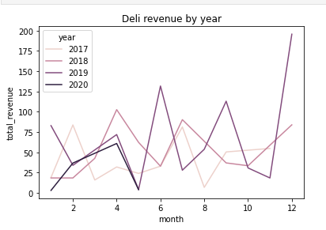
Analysis by Commodity – Frozen foods
Analysis by Department - Deli

Slide 13
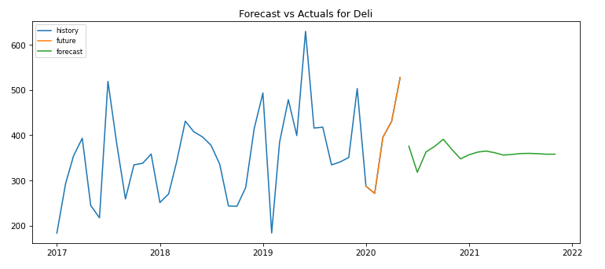
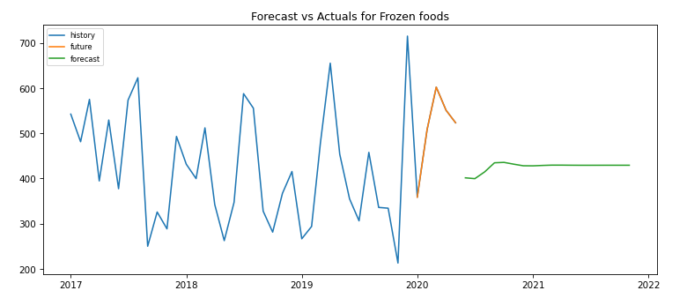
Forecasting using ARIMA model

Slide 14
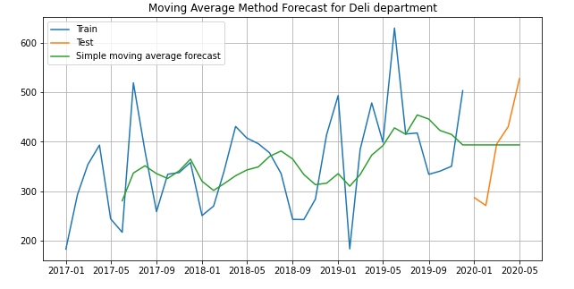
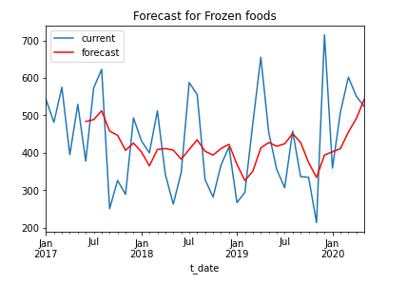
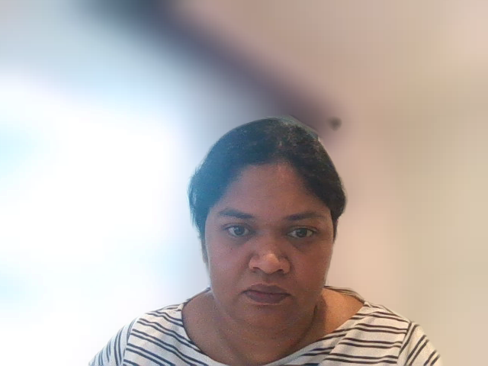
Forecasting using Moving Average Method
Notes:
This is another Forecasting of Deli department and Frozen foods commodity done using moving average method in predictive analytics modelling.
The graph shows the current revenue over the forecast revenue

Slide 15
In this digital world, businesses cannot strive without moving towards online shopping. So SuperFoodsMax must develop plans to introduce online shopping. How to increase the average spend of loyal customers? Introducing Loyalty points scheme where the points could be claimed for discount or products. 2 for 2000 offers: Buy for 2 weeks for $(min amount like $100) and get 2000 points. Introducing Free home delivery when doing a transaction above certain amount in online shopping. How to convert the first-time customers to regular customers? Giving birthday vouchers for a certain amount when the transaction is above a minimum amount. Introducing festival vouchers by redeeming loyalty points. Getting customer feedback through surveys, and focusing on customer preferences. Any other way to increase the revenue growth? Introducing bulk buy items at a certain discount. This will ensure more revenue per basket and increase revenue from promiscuous customers. More loyalty points for low selling commodities. Removing lowest revenue yielding commodities from the shelf. Adopting these suggestions might help SuperFoodsMax to see a revenue growth over the next few months.
Suggestions for increasing the revenue growth

Slide 16
Thank you
Video Presentaion Link:
https://rmit-arc.instructuremedia.com/embed/f4da73d5-f10d-4367-9980-d9de4ab1b4b3

